Slide 1








Slide 2
Estimation of Concrete Compressive Strength
Presented by,
Soujanya

Slide 3
Abstract
Concrete is the most important material in civil engineering. Knowing the compressive strength of concrete is very important when constructing a building or a bridge. The concrete compressive strength is a highly nonlinear function of age and ingredients. Thus, using Machine Learning to predict the Strength could be useful in generating a combination of ingredients which result in high Strength.
Problem Statement
Predicting Compressive Strength of Concrete given its age and quantitative measurements of ingredients.

Slide 4
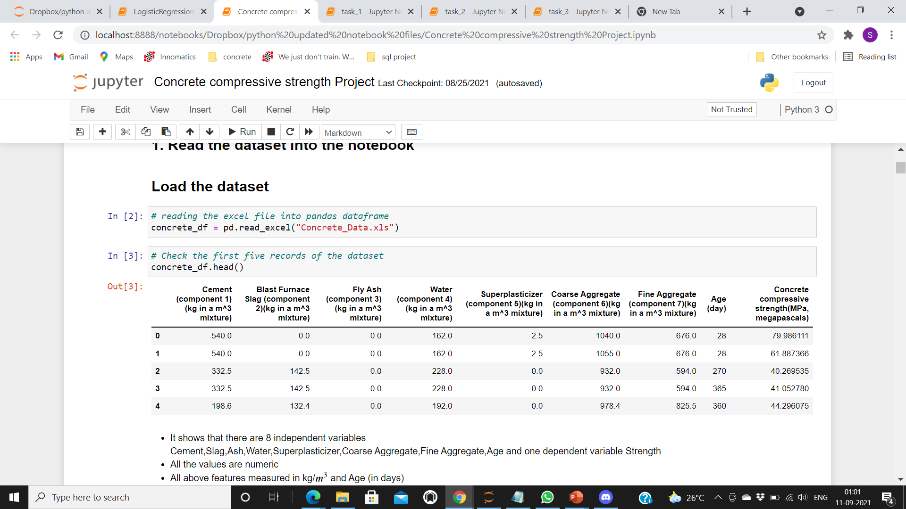
Insights From Data
Number of instances(observations) – 1030
Number of attributes - 9
There are 8 independent features and 1 dependent feature.
Independent Features
Cement
Blast furnace Slag
Fly Ash
Water
Super plasticizer
Coarse Aggregate
Fine Aggregate
Age
Dependent Feature
Concrete Compressive Strength
They are no null values present in the data.
All the values are numeric
All above features measured in kg/ 𝑚3 and Age (in days)

Slide 5
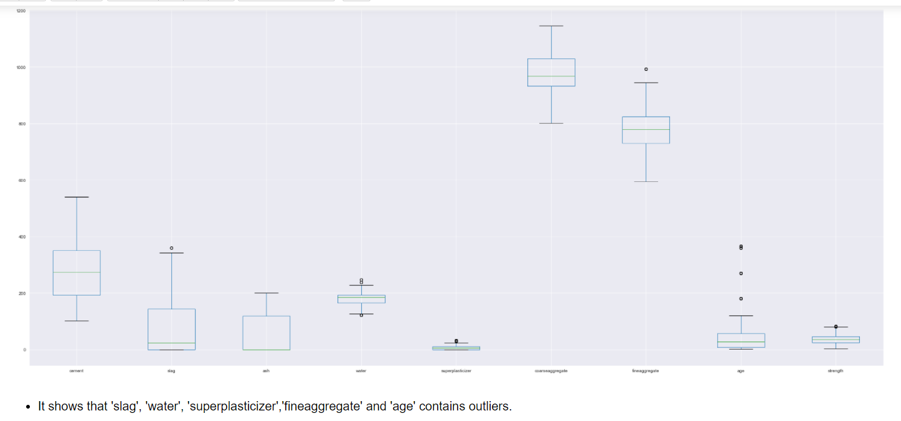
Detecting and Treating Outliers
Used IQR (Inter Quartile Range) method to detect outliers in all features.
Identified outliers in
Blast furnace slag
Water
Super plasticizer
Fine aggregate
Age
Replaced the outliers in these features with their lower and upper bounds.

Slide 6
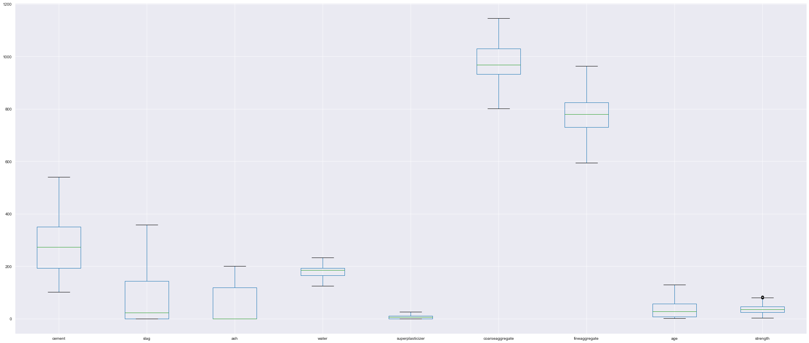
After Treating Outliers
There are no outliers present in 'slag', 'water', 'superplasticizer','fineaggregate' and 'age’.

Slide 7
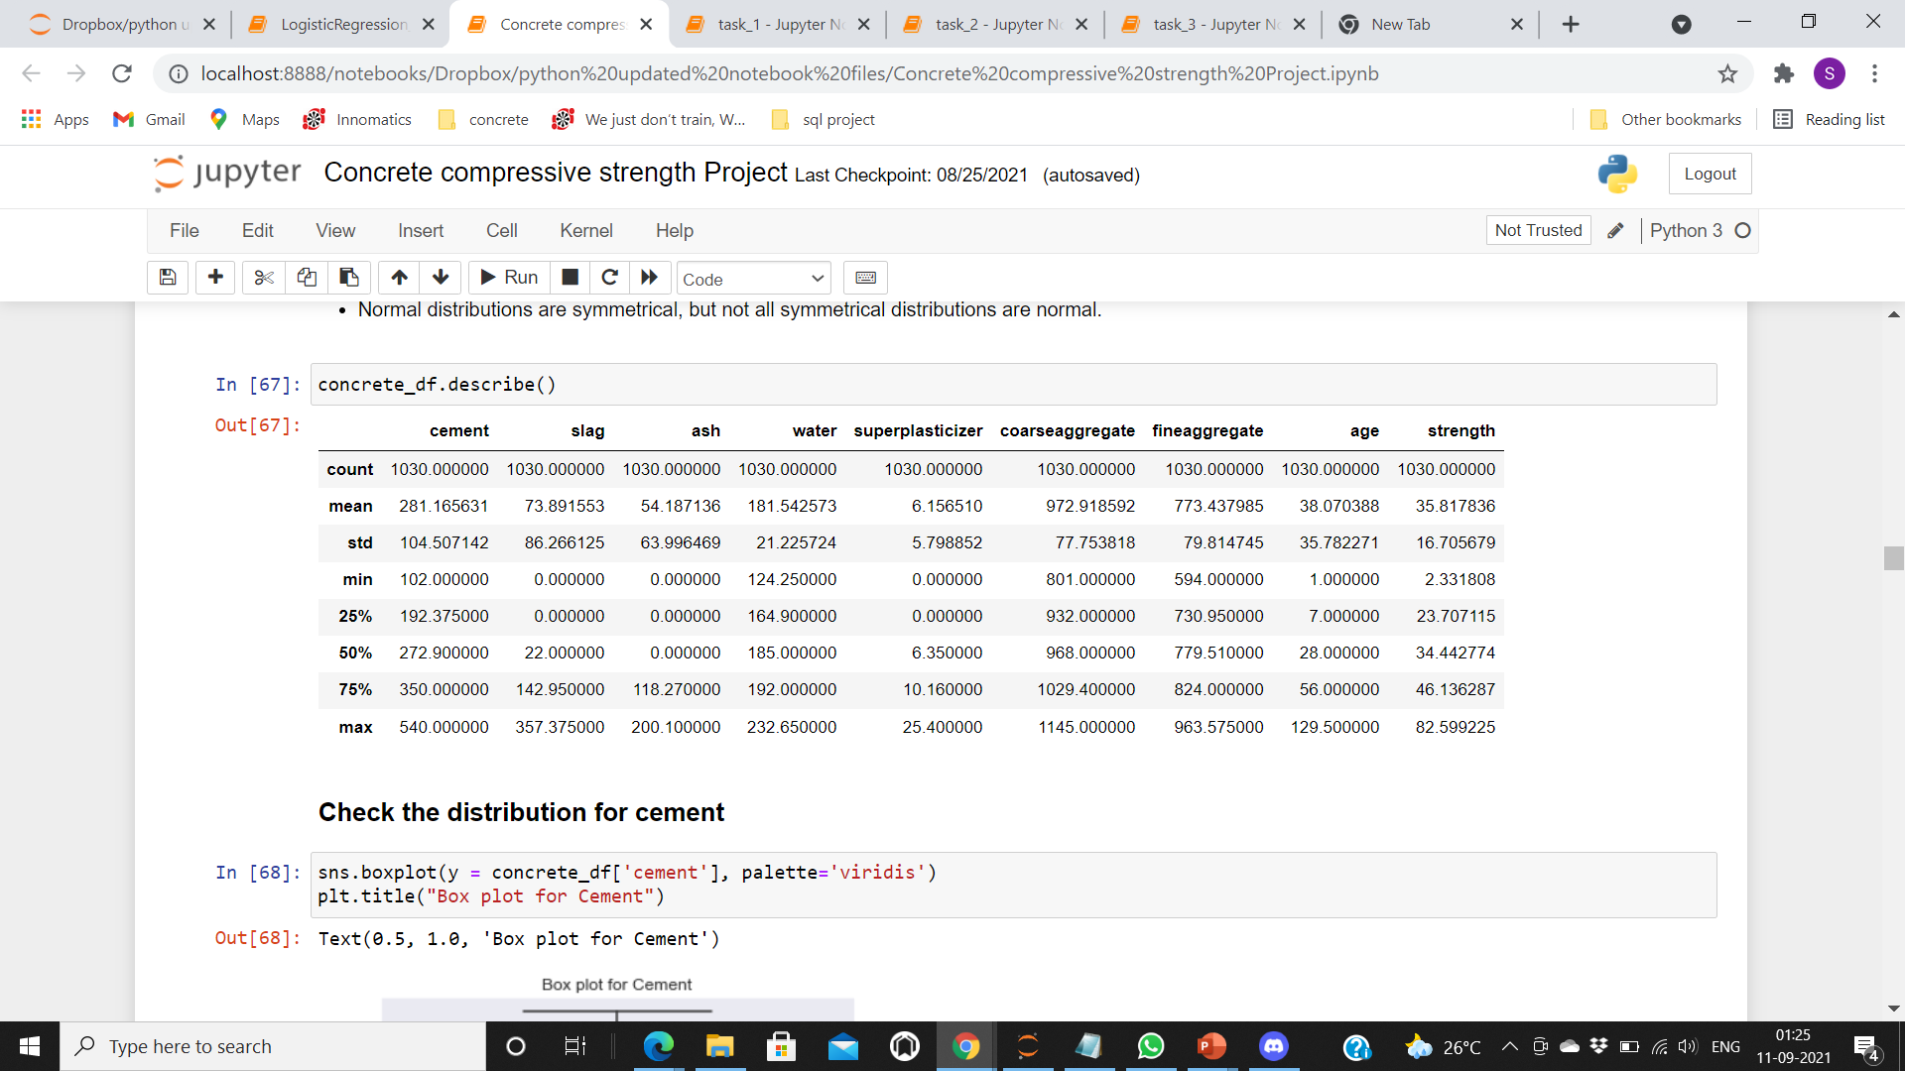
Data visualization
Basic Statistics on Numerical Features:
We can observe that cement, slag, ash are right skewed distribution.

Slide 8
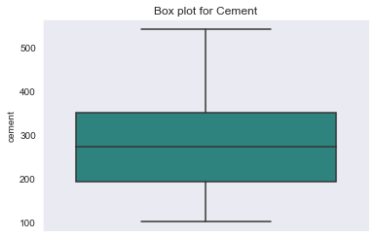
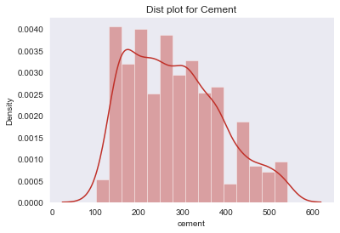
Check the distribution for cement
They are no outliers present.
Spread of data is in between 102 - 540
Median is around 272.9
We can see, Cement is almost showing normal distribution, as most of the data is distributed from 100 to 350.

Slide 9
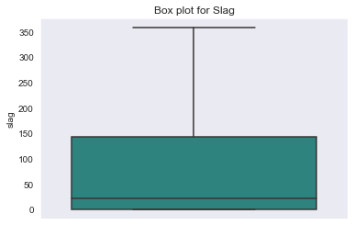
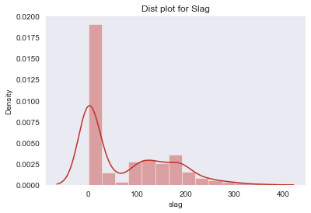
Check the distribution for slag
They are no outliers present.
Spread of data is in between 73.89 - 357.37
Median is around 22
It has two gausssians.
We can see, Slag is showing right skewed distribution.

Slide 10
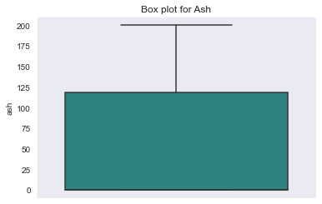
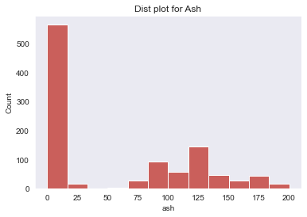
Check the distribution for ash
They are no outliers present.
Spread of data is in between 0 - 200
Median is around 0
It has two gaussians.
We can see, Ash is showing right skewed distribution.

Slide 11
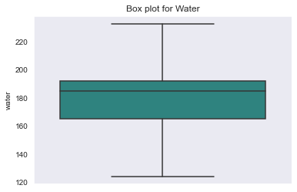
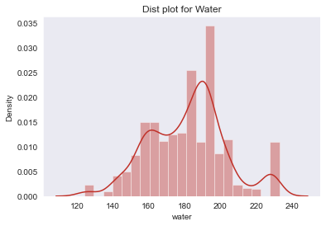
Check the distribution for water
They are no outliers present.
Spread of data is in between 124.25 - 232.65
Median is around 185
It has three gaussians.
We can see, Water is showing left skewed distribution, as most of the data is distributed from 120 to 180.

Slide 12
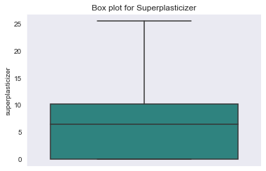
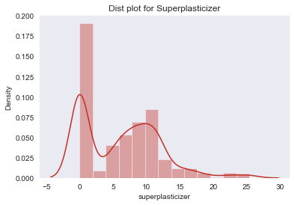
Check the distribution for superplasticizer
They are no outliers present.
Spread of data is in between 0 - 25.4
Median is around 6.35
It has two gaussians.
We can see, Superplasticizer is showing left skewed distribution.

Slide 13
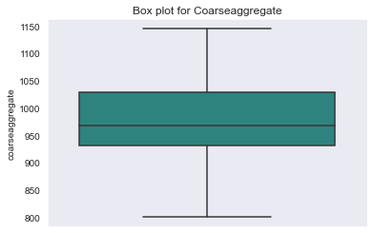
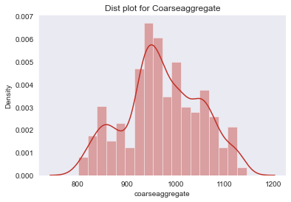
Check the distribution for coarseaggregate
They are no outliers present.
Spread of data is in between 801 - 1145
Median is around 968
It has three gaussians.
We can see, Coarseaggregate is almost showing normal distribution

Slide 14
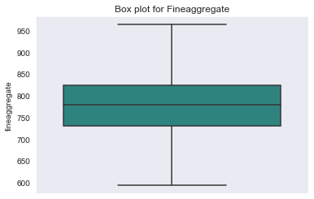
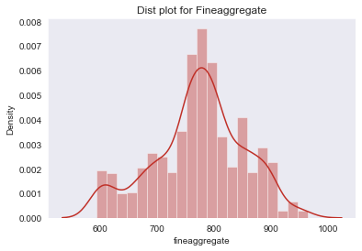
Check the distribution for fineaggregate
They are no outliers present.
Spread of data is in between 594 - 963.57
Median is around 779.5
It has almost two gaussians.
We can see, Fineaggregate is almost showing normal distribution.

Slide 15
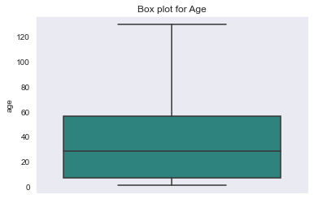
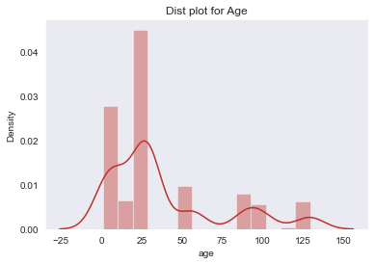
Check the distribution for age
They are no outliers present.
Spread of data is in between 1 - 129.5
Median is around 28.
It has multiple gaussians.
We can see, Age is showing right skewed distribution.

Slide 16
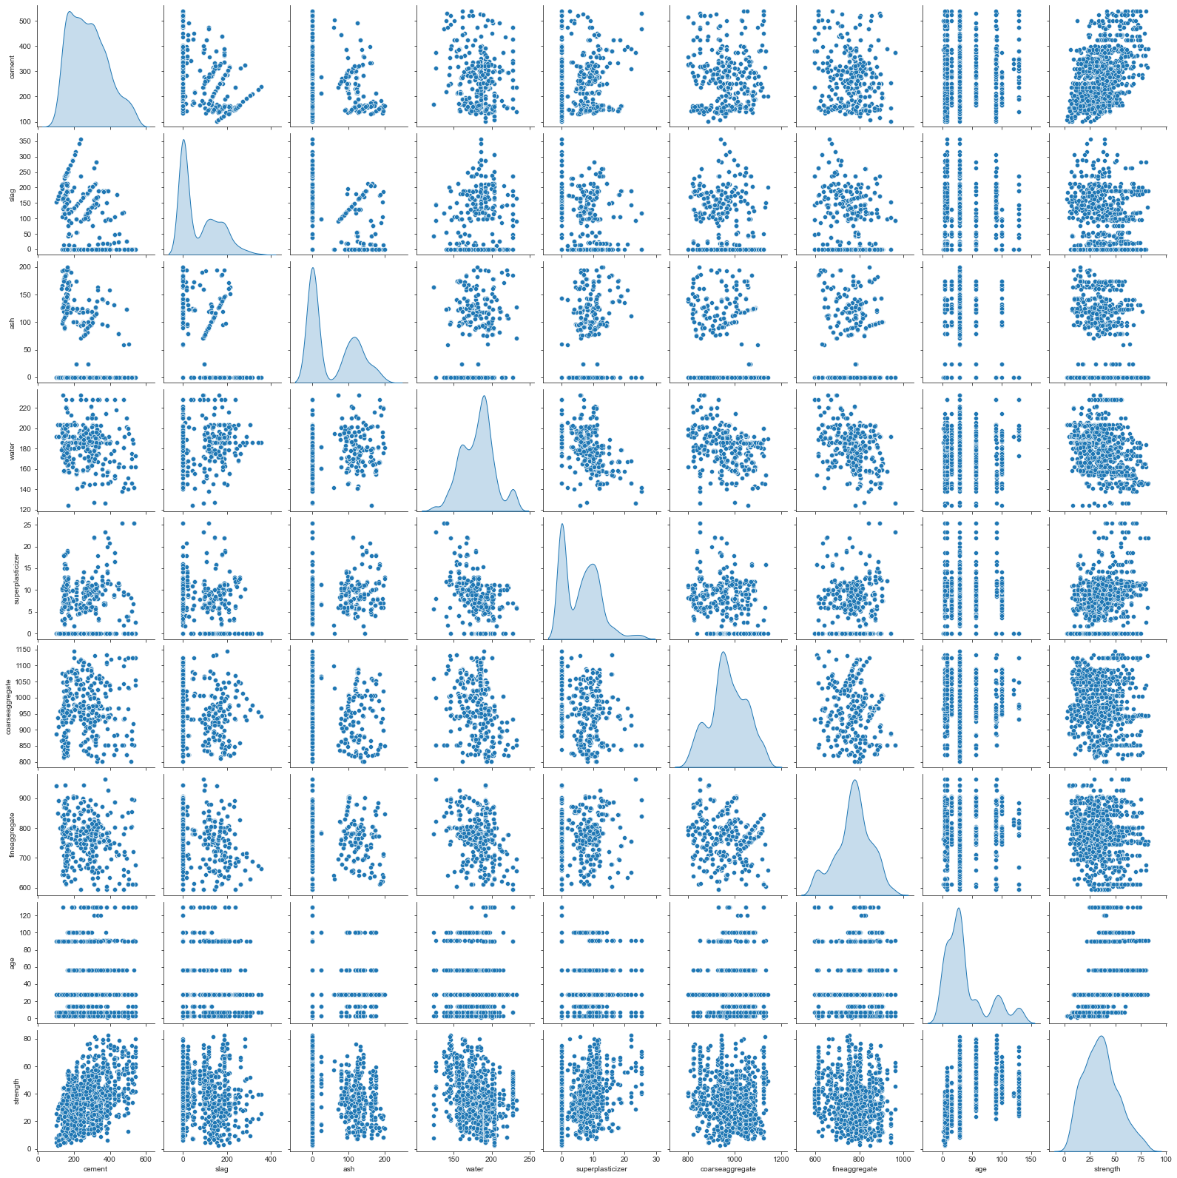
Relationship between independent features
1.Cement vs other independent attributes: This attribute does not have any significant relation with slag, ash, water,superplasticizer, coarseaggregate,fineaggregate and age.
2.Slag vs other independent attributes: This attribute also does not have any significant relation with cement, ash, water, superplasticizer, coarseaggregate,fineaggregate and age.
3.Ash vs other independent attributes: This attribute also does not have any significant relation with cement, water, superplasticizer, coarseaggregate,fineaggregate and age.
4.Water vs other independent attributes: This attribute have negative linear relationship with superplasticizer and fineaggregate. It does not have any significant relationship with other independent atributes.
5.Superplasticizer vs other independent attributes:This attribute have negative linear relationship with water only. It does not have any significant relationship with other independent attributes.
6.Coarseaggregate vs other independent attributes:This attribute also does not have any significant relation with any other attributes.
7.Fineaggregate vs other independent attributes:It has negative linear relationship with water. It does not have any significant relation with any other attributes.

Slide 17
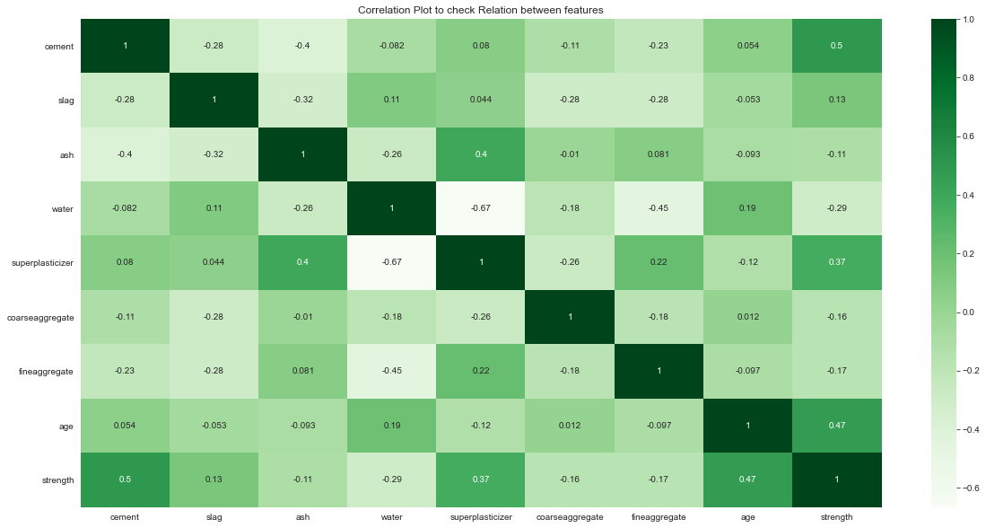
Check Co-relation between features
Strength shows positive relationship with age, superplasticizer, slag and cement
Ash and superplasticizer are positively correlated with each other.
Water shows significant negative relationship with superplasticizer and fineaggregate. It also shows some kind of positive relationship with slag and age.

Slide 18
Type of Machine Learning Problem
The machine learning problem is a supervised learning model.
It is a Regression problem as we are predicting a continuous numerical value i.e., Concrete Compressive Strength.
Train Test Split
First standardised the data using StandardScaler().
Then, split the data into training data (80%) and testing data (20%) using train_test_split() function from sklearn library.
Evaluation Metrics
Root Mean Squared Error (RMSE)
Mean Squared Error (MSE)
Mean Absolute Error (MAE)
Coefficient of Determination (R square)

Slide 19
Machine Learning Regression Models
Linear Regression
Lasso Regression
Ridge Regression
Decision Tree Regressor
Random Forest Regressor
KNN Regressor (KNeighborsRegressor)
SVM Regressor

Slide 20
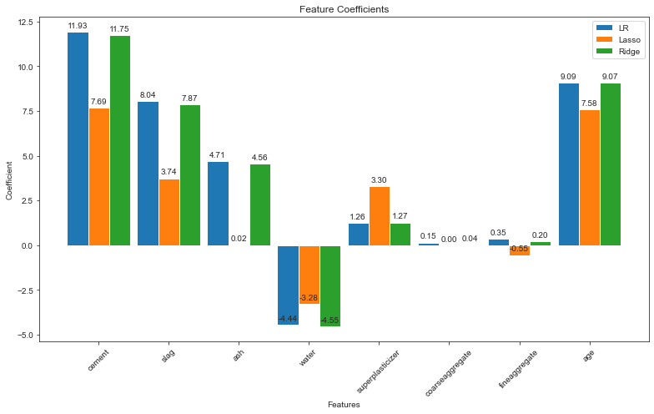
Plotting the coefficients for Linear, Lasso and Ridge models
The coefficients with Linear, Lasso and Ridge are almost same.

Slide 21
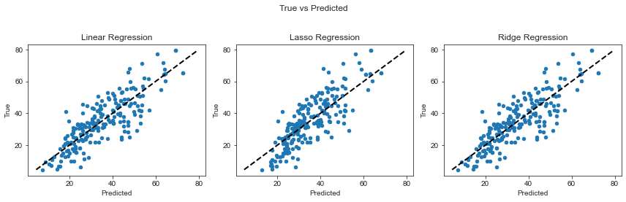
Plotting the predictions for Linear, Lasso and Ridge models
By observing at the graphs between predicted and true values of the target variable, we can conclude that Linear, Lasso and Ridge Regression perform well as the predictions are closer to the actual values.

Slide 22
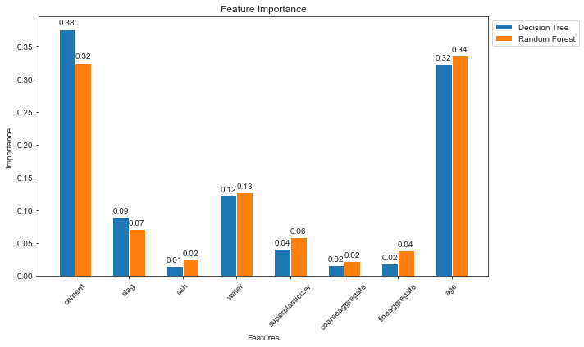
Feature importance's for Decision Tree and Random Forest
We can see that cement and age are treated as the most important features by tree based models. Ash, coarseaggregate and fineaggregate are least important factors when predicting the strength of concrete.

Slide 23
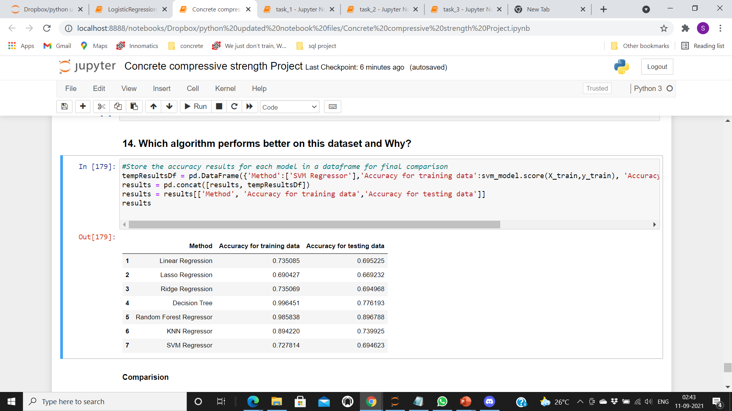
Performance of Models
The accuracy scores for training data are almost similar in linear, lasso and ridge regression.
The accuracy scores for testing data are almost same in linear, lasso and ridge regression.
In Decision tree, the dataset is performing 99% accurately in training data. Training score is better than test score.
In Random Forest, the dataset is performing 98% accurately in training data. Training score is better than test score.
In KNN regressor, the dataset is performing 89% accurately in training data. Training score is better than test score.
In SVM regressor, there is a slight difference in training score and testing score. Training score is better than test score.

Slide 24
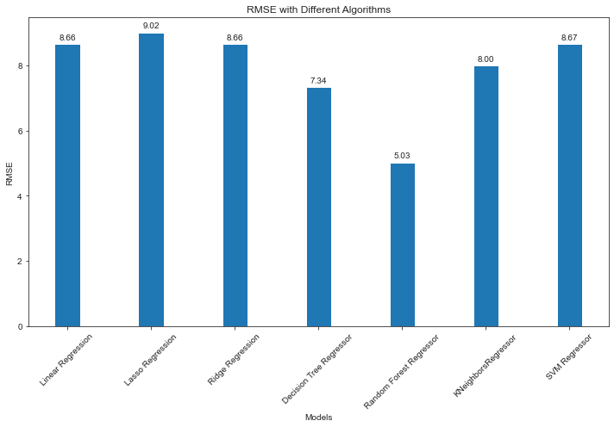
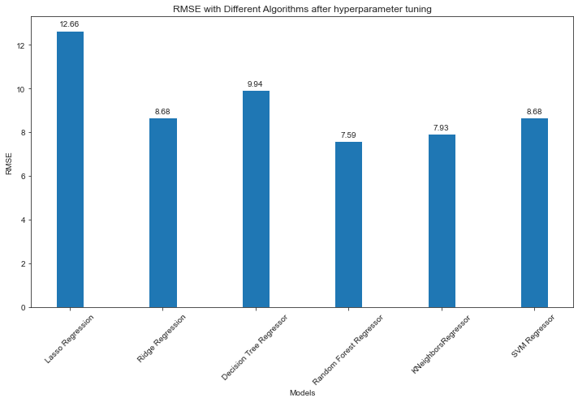
Compare RMSE for Different Models before and after Hyper parameter tuning
We can observe that the RMSE scores of RandomForestRegressor before and after hyperparameter tuning is less.
The accuracy score of RandomForestRegressor is 89% highest among other algorithms, so we use the RandomForestRegressor model.
Also, RandomForestRegressor gives less error rate RMSE is 5.03.

Slide 25

THANK YOU

